Slide 1
Universal Charter
A program for charting with support of various formats for VSRGs.
(currently not finished)

Slide 2
Why did I decide to do this.
I wanted to start with a long-term project.
Address various issues I have with current charting tools
It would be more ideal to combine multiple formats into one program

Slide 3
What are the issues I have with current tools
Starting with the osu! editor:
No waveform to accurately chart notes
Cannot chart beyond 1/16 notes per bar. (SM can chart to 1/48 per bar)
No note color to signify what that note is charted to
No custom skin support for user readability of notes
Stepmania Editor:
Does not save user settings after exit
Controls are not ideal (ctrl+up/down for volume control, everything is handled with ctrl, alt, shift + any arrow)
Chords are not emphasized when toggle note sounds
Skin support exists, but its very limited to a size of 4 skins, having to modify the preexisting skins.

Slide 4

Comparison/Inspired By

Slide 5
Compatibility
It would be more ideal to combine multiple formats into one program.
They are handled as text files and they all have similar traits, you just have to parse them differently.
The current tools do not support each other’s format

Slide 6
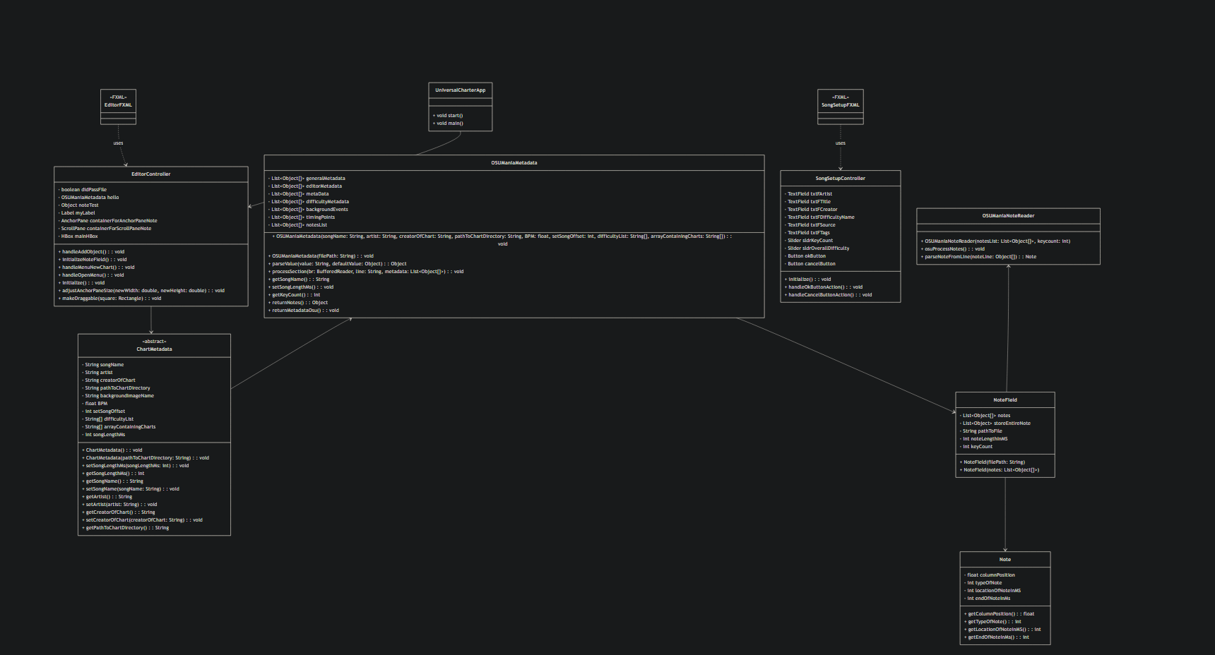
UML Diagram

Slide 7
What it currently does
I was successfully able to parse all of the data in the .osu format.
Required reading documentation: https://osu.ppy.sh/wiki/en/Client/File_formats/osu_(file_format)#type
When ran, It prints out commands of what it has processed and also resizes the scrollpane based on how many columns of keys are detected. 100px wide per key

Slide 8
What is not completed
I wanted to implement the placing of notes onto this scroll pane
Requires the song length
Requires getting the BPM of the song
Need to place the BPM lines and their dividers (1/4, 1/8, etc)
With that what I was going for was get the note data, find its placement in terms of ms of the song, snap that note to the closest divider in ms.
Reason why I was thinking this:
If you know the start and ending time of the song in ms, you can cut up the song based off of the BPM of the song, and with that you know where each BPM line exists in terms of ms. You can break down even further based off note placement.
There are a few audio format that some of these charts uses. Mostly .mp3 and .ogg. I was not able to successfully read them.

Slide 9
Overview of the Project
Personal long term project which will probably simplify charting by combining all the good things about their respective editor.
I have features in mind that I want to explore
Utilize the skins in their respective games, accurately resemble them in the editor.
Perhaps a Youtube video to Chart converter. Process a video containing a chart, convert and place onto the editor.
Support for not explored formats: I have access to some arcade song data and would like to parse them.

